Slide 1

Coding Lesson 2
Number Calculations and Data Types
Elementary Coaches Academy

Slide 2
Log into your Scratch account
https://scratch.mit.edu

Slide 3

Warm up
Open the starter File
https://scratch.mit.edu/projects/227504750/
Run the program by clicking the flag icon

Slide 4


Adding a New Command
Click the Data menu
Add a command in the loop to make the length grow by 1 each turn.
https://scratch.mit.edu/projects/227505753/
Use these two blocks

Slide 5
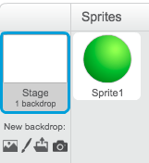
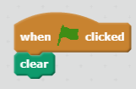
Clearing the Screen
How do you clear the screen?
Click the background → Stage
Select PEN and add a clear command
Add the blocks to the stage

Slide 6
Let’s Do the Math
The whole purpose of early computers was to do number calculations. They were really just big calculators.

Slide 7
Definition: Operations
The number calculations a computer program can do.
What examples of operations did we see in this program?

Slide 8
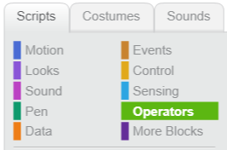
Lab Lecture
Click the operators menu
What math operators are built into Scratch?

Slide 9
Lab Lecture
Start a new program so it asks the user to enter a number:
Print the number multiplied by 20.

Slide 10
Lab Lecture
What happens when you enter a decimal?

Slide 11
Lab Lecture
What happens when you enter a word instead of a number?

Slide 12
Definition: Data Type
The kind of data a user types in
Numbers used for calculations
Words NOT used for calculations
Some books call these Strings

Slide 13
Lab Lecture
Change your program so it asks the user to enter a number:
Print the number divided by 10.
Do you get a decimal?

Slide 14

Lab Lecture
Change your program so it asks the user to enter a number:
Try the sqrt block.

Slide 15
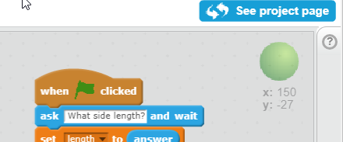
Lab Lecture
What does this do?
help menu

Slide 16
Lab Lecture
Input a number
Display the number MOD 10
Notes:
Show them how to create a variable in the data menu

Slide 17
Lab Lecture
What does MOD do?
Display the number MOD 5
Notes:
Show them how to create a variable in the data menu

Slide 18
Definition: MOD
Gives the remainder when doing division.

Slide 19
MOD is used for:
Patterns in programs (Pac Man)
Colors
Changing bases:
Time
Money
Checking if numbers divisible (even/odd)

Slide 20
Lab Lecture
Try MOD:
4
3
17
Notes:
Show them how to create a variable in the data menu

Slide 21
Lab Lecture
If we do MOD 4
How many possible answers?
Lowest?
Highest?
Notes:
Show them how to create a variable in the data menu

Slide 22
Practice Exercises
http://bit.ly/2Hma8Na
Mild - perfect for beginners
Medium - expanding your skills
Spicy - looking for a challenge?

Slide 23
Journal
Besides math, how could you connect number calculations in Scratch to the core subjects?

